Slide 1

Hibernate ORM Tool
Smart Data Persistence using ORM
MKJ IT Solutions

Slide 2

What we cover
In this course we will understand the ORM requirement , the need of ORM and how to prepare our machine for development.
We will also cover the few basic annotations and mappings

Slide 3
What Audience will achieve after this course
After the completion of this section the participant will be able to implement the ORM specific guidelines to implement data persistency.
Participant will be able to understand and implement the configuration required for the development.

Slide 4
Objectives to be cover
Understand the ORM and its need.
Machine setup
Basic Introduction.
JPA Annotations and the way to persist data
Mapping composite and collection types.
Entity association

Slide 5
What is Hibernate?
Many attempts have been made to bridge relational and object-oriented technologies or to replace one with the other, but the gap between the two is one of the hard facts of enterprise computing today. It is this challenge—to provide a bridge between relational data and Java objects—that Hibernate takes on through its object/relational mapping (ORM) approach. Hibernate meets this challenge in a very pragmatic, direct, and realistic way.

Slide 6
Introduction
Hibernate is flexible and configurable ORM Solution.
Hibernate is an open source solution for Java persistence.
Its is based on the idea of ORM, which is a technique to map object model with relational model.
So through hibernate we can map associated,inherited , polymorphic, composite or collection based objects directly to relational database.
Working with objects and relational database could be complex, hibernate makes it easier.

Slide 7
How Hibernate helps us
Database independent.
Different types of Mapping
HQL
State management
Native SQL Query and Criteria Qery
Cache
Various Primary key strategies.
Helps over JDBC issues

Slide 8
Setting up Development environment
What we need.
Eclipse IDE (or any java specific IDE).
Hibernate Plugin support. (Jboss tools)
Hibernate Jars or Maven support.
Database (pfb the download link of Oracle XE)
https://www.oracle.com/technetwork/database/database-technologies/express-edition/downloads/xe-prior-releases-5172097.html
Understanding of Java and JDBC.

Slide 9
Create Basic Application
Create cfg file
Pojo
XML approach
@Annotation approach
Database execution code

Slide 10
Understanding Session Factory
https://docs.jboss.org/hibernate/orm/3.5/api/org/hibernate/SessionFactory.html
SessionFactory is immutable instance.
Usually a single instance per application.
Instances of SessionFactory are thread-safe and typically shared throughout an application.
Use to retrieve session.
Used to contain connection information such as hibernate configuration information, mapping files, location path.

Slide 11
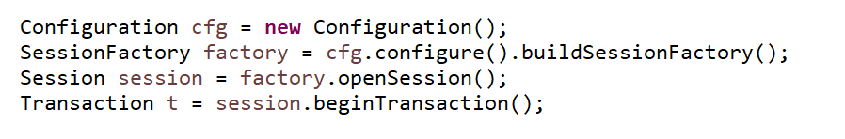
How to access Session Factory
Hibernate sessionFactory.openSession() method used to create new session.
We can close this session once we done with database operations.
In best practice : we should create one session for each request in multi-threaded application or web application.

Slide 12
Understanding Annotations
@ Entity This annotations are from
@ Table javax.persistence.*
@ ID
@ GeneratedValue and its Strategies
@ Column
@ OrderBy

Slide 13
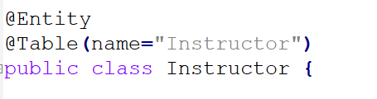
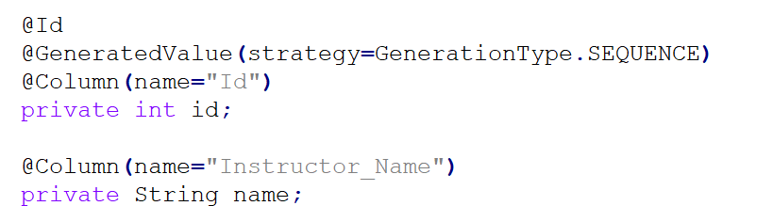
Usage of Annotations
@Entity : Specifies that the class is an entity. This annotation can be applied on Class, Interface of Enums.
@Table : It specifies the table in the database with which this entity is mapped.
@Column : Specify the column mapping using @Column annotation. Use it to override default values
Updatable = false/true, name=”MyNewColumnName” , nullable= false, length = 50
@ID and @GeneratedValue: This annotation specifies the primary key of the entity and Generated value specifies the generation strategies for the values of primary keys.
JPA strategies
AUTO, TABLE , IDENTITY , SEQUENCE.
@OrderBy : Sort your data using @OrderBy annotation.

Slide 14
Hibernate CURD API
Session.save(entity reference);
Session.get(EntityCLass,ID);
Session.update(entity reference);
Session.delete(entity reference)

Slide 15
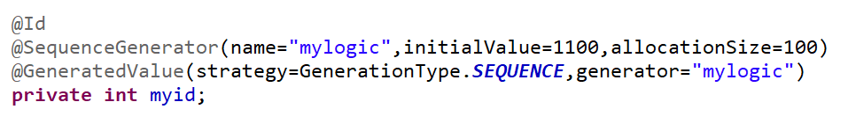
Controlling Primary Key
@GeneratedValue annotation, which the increase type for auto increment column.
@SequenceGenerator annotation is used to govern auto increment behaviour.

Slide 16
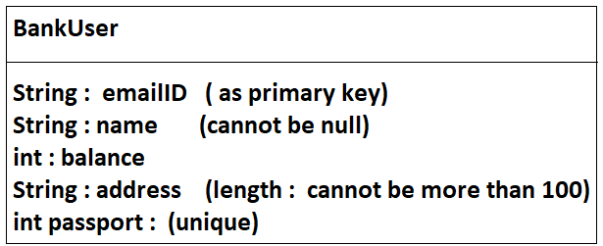
Assignment
Create a Hibernate specific application to store the information of the client.
Perform all CURD operations on the record, using Hibernate CURD API.

Slide 17
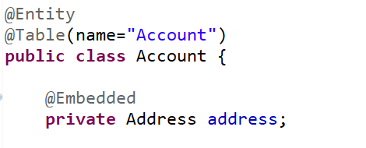
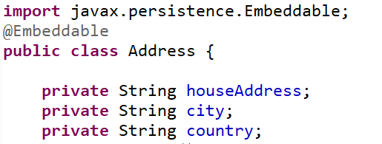
Understanding Object Type
Type of Objects.
Value Objects are the objects which can not stand alone.
Entity Objects are those who can stand alone like College and Student.
When we define the value object for the entity class we use @Embeddable.
When we use value type object in entity class we use @Embedded.
Use @AttributeOverrides to override the column information

Slide 18
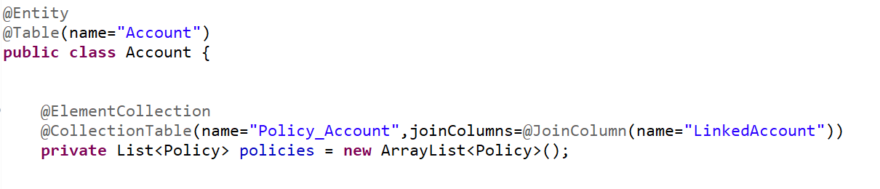
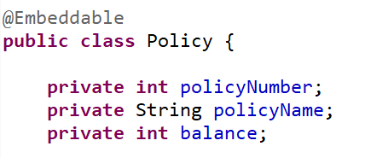
Saving Collection Objects
Need to store the information in separate table

Slide 19
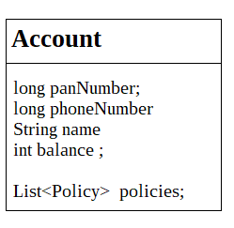
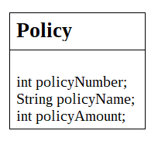
Assignment
For the below classes , save the information in the database.
For Account Table primary key should be started from 1000 and incremented by 10
And for collection table , foreign key name must be “linkedAccount” and table name must be “Account_Policy”.
Policy table also has auto incremented primary key through @GenericGenerator.
Read all policies related to Account

Slide 20


